Slide 1
Libraries Transform
SDLA 2016
Elizabeth Fox

Slide 2
What is the Libraries Transform Campaign?
Multi-year
Advocacy
Libraries Transform Because….

Slide 3
Messaging
Libraries are at the heart of our communities—a resource for people of any age to find what they need to help improve their quality of life.
Our society is at a critical juncture with regard to the changing information landscape and the skills needed to thrive in our digital world.
Libraries are committed to advancing their legacy of reading and developing a digitally inclusive society.
Libraries also are expanding beyond their traditional roles and providing more opportunities for community engagement and delivering new services that connect closely with patrons’ needs.
Libraries of all kinds add value in five key areas: education, employment, entrepreneurship, empowerment and engagement.
Library professionals facilitate individual opportunity and community progress.
Today’s libraries are not just about what we have for people, but what we do for and with people.
Libraries are evolving with these changes in order to serve the public and to continue to fulfill their role in leveling the playing field for all who seek information and access to technologies.
Notes:
We all know that we are a valuable resource to our communities and that, in most cases, we should be better funded. What we are not that good at is making sure that those in power know that – and not only know but really understand.
Libraries transform is intended to increase public awareness of the value, impact, and services provided by libraries and library professionals. By participating in this national campaign, those in power around us will not just hear our puny little voice saying “I’m important, give me money so I can work for your constituents,” they will hear hundreds or thousands of puny little voices combined into one big powerful voice that they can’t ignore.
However, the campaign can be used not just for those in our funding sources, whatever that source may be, it can be used internally for staff, trustees, volunteers, and Friends. It can be used to promote your services to your patrons. It can be used in advertising to supplement or simply freshen what you already do. It can be used to help promote programs you are planning. It is flexible enough to help whenever you have a message to convey.
There are, however, some key messages within the campaign.
Today’s libraries are not just about what we have for people, but what we do for and with people.
Libraries are at the heart of our communities—a resource for people of any age to find what they need to help improve their quality of life.
Our society is at a critical juncture with regard to the changing information landscape and the skills needed to thrive in our digital world.
Libraries are evolving with these changes in order to serve the public and to continue to fulfill their role in leveling the playing field for all who seek information and access to technologies.
Libraries also are expanding beyond their traditional roles and providing more opportunities for community engagement and delivering new services that connect closely with patrons’ needs.
Library professionals facilitate individual opportunity and community progress.
Libraries are committed to advancing their legacy of reading and developing a digitally inclusive society.
Libraries of all kinds add value in five key areas: education, employment, entrepreneurship, empowerment and engagement.

Slide 4
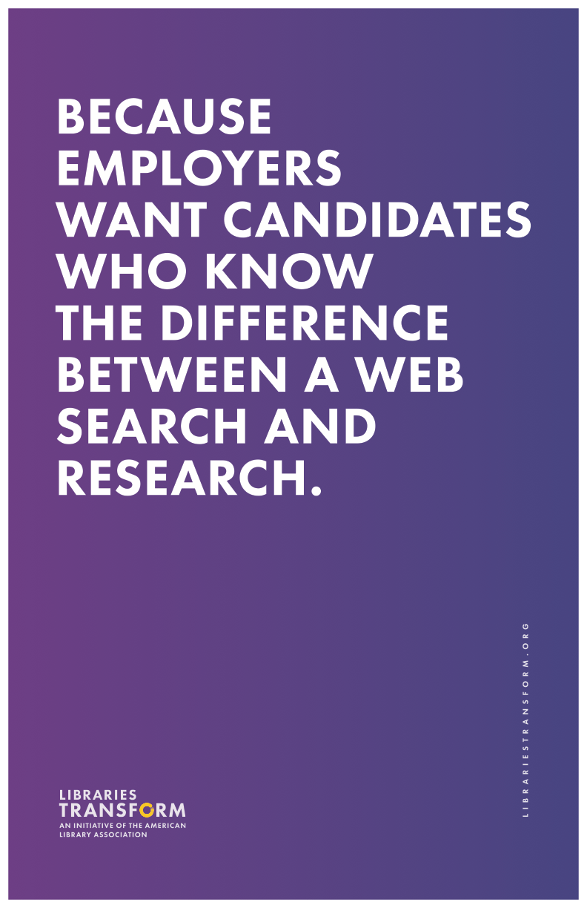
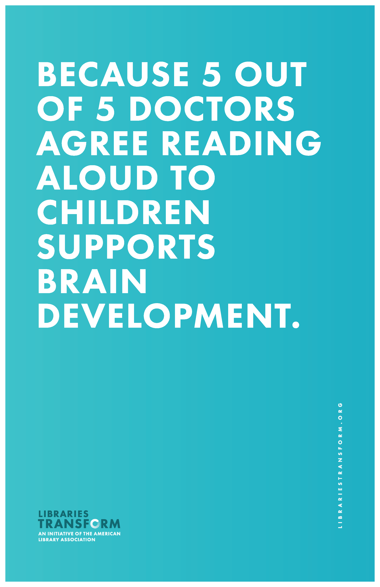
How are these messages formatted?
Because ….
Notes:
These messages are being sent out with the lines ”Libraries Transform Because….”
Because employers
Because adding minecraft
Because 5 out of 5...
And there are more

Slide 5
How can you use the campaign?
Use the posters, postcards, bookmarks, and banners ALA has produced
Make your own materials
The ALA booth has mini-postcards, posters, and window clings
This year we are featuring librarians
Libraries Transform - I’m an expert in [fill in the blank – be creative!]
The ALA booth is making I’m an expert badges for you with your picture!
The cost for the badges is very high – you actually have to talk to me.
Notes:
The campaign is designed to be very flexible. You can sign your library up and you get access to the tool kit with several downloadable pdf posters, postcards, bookmarks, banners, etc.
You can edit the documents as well to make them your own. Minnesota has adopted the campaign as a state library association and is putting their logo on it.
I put the proposed new SDLA logo on the window clings at the ALA booth (so I am really hoping the logo is adopted)!
You can make your own Because statements and make your own materials.
At the ALA conference, one of the booths made a Because wall and people put post-it notes on the wall. The theme was a little different as it dealt with LGBTQ issues (remember the conference was in Orlando about 2 weeks after the mass murders there).
Let your patrons tell you how you transform them by hosting your own because wall. Use post-it notes or whiteboard paint on a wall of your library or let people record video of themselves to post on your Facebook or Instagram site.
The campaign can do whatever you can imagine it to do.
Find a problem – use the campaign and your imagination to spread the word. Libraries Transform Because but we need your help to do even more.

