Slide 1




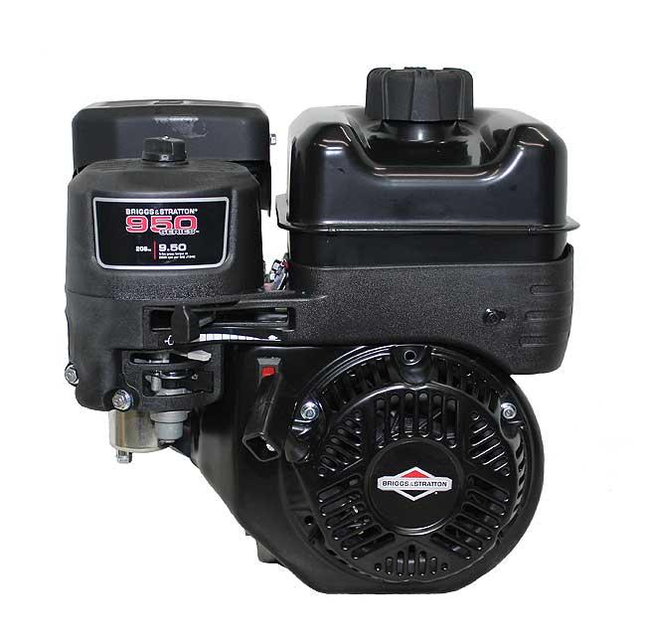
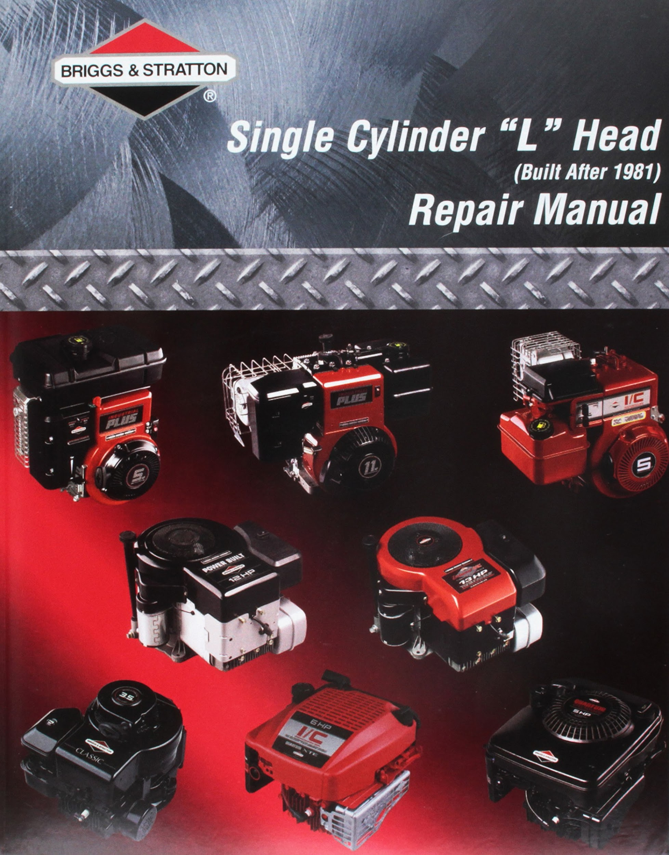


Small Gasoline Engines
Interactive
Notebook
Name: _____________________________
Class : _____________________________

Slide 2
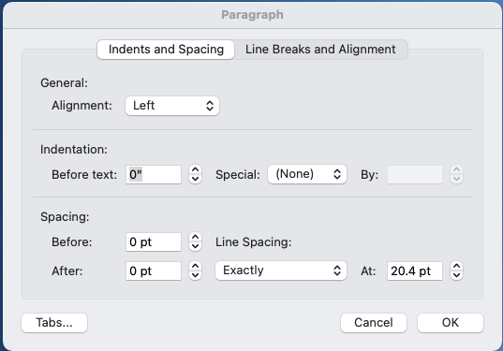
Small Gas Engines.
Student Interactive Notebook
On the right side of every page is a section for student notes, or a series of reflection questions related to the content on the left of the page.
To align text with notebook lines, set paragraph line spacing to “Exactly” at 20.4 pt.
This interactive student notebook is designed to be used with both the Briggs Power Portal, and the Small Engines (4th Ed. By Bruce Radcliff) Text.
In addition, students will need Illustrated Parts Lists, Repair Manuals, and Engine Specifications Sheets (torque values & reject sizes) for the engine they are working on. All the additional references are available through the Educational Resources tab in the Power Portal.
Students will also need access to a camera of some sort. Phones or tablets would work great for these parts of the notebook.
Please send comments, suggestions, errata, or ways you use the notebook to Dr. P. Troy White (peter.white@sdstate.edu), SDSU Ag Education.
This notebook is provided free of charge under the Creative Commons Licensing (Attribution 3.0 Unported [CC BY 3.0])
Please cite author and institution when referencing this work.
Attribution 3.0 Unported (CC BY 3.0)

Slide 3
Relevant standards, performance indicators, and objectives from the National AFNR Standards:
AFNR.PST.03. | CCTC Standard: Service and repair AFNR mechanical equipment and power systems.
AFNR.PST.03.01. | Performance Indicator: Troubleshoot, service and repair components of internal combustion engines using manufacturers' guidelines.
AFNR.PST.03.01.01.a | Identify and classify components of internal combustion engines used in AFNR power, structural and technical systems.
AFNR.PST.03.01.01.b. | Analyze and explain how the components of internal combustion engines interrelate during operation.
AFNR.PST.03.01.01.c. | Evaluate service and repair needs for internal combustion engines using a variety of performance tests (e.g., manuals, computer-based diagnostics, etc.).
AFNR.PST.03.01.02.a. | Distinguish the characteristics of spark-and-compression internal combustion engines used in AFNR power, structural and technical systems.
AFNR.PST.03.01.02.b. | Utilize technical manuals and diagnostic tools to determine service and repair needs of spark-and-compression internal combustion engines used in AFNR power, structural and technical systems.
AFNR.PST.03.01.02.c. | Inspect, analyze and repair spark-and-compression internal combustion engines used in AFNR power, structural and technical systems.

Slide 4
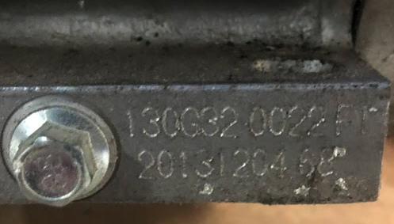



Important Links for the Class :
Briggs & Stratton Power Portal
Add photos of your engine, include multiple angles.
SAMPLE PHOTO
My Engine #1
Orientation:
Model:
Type:
Code:
Attribution 3.0 Unported (CC BY 3.0)

Slide 5
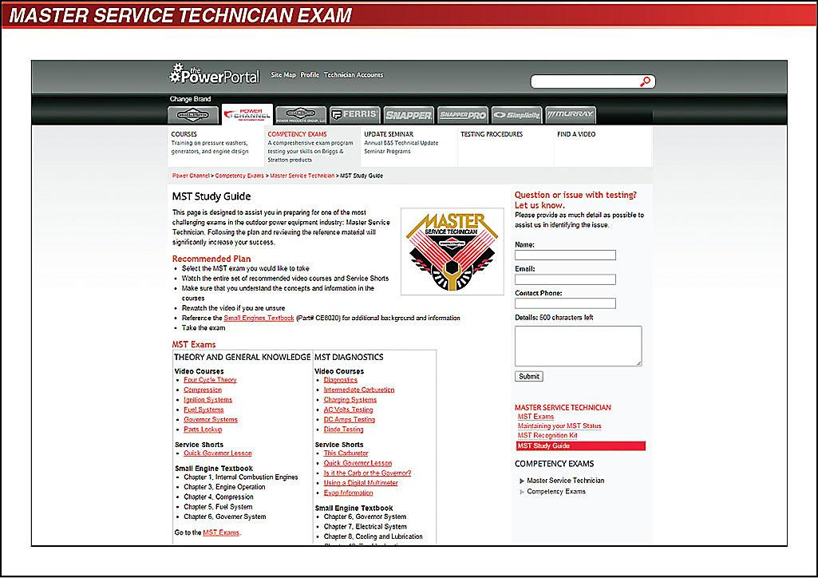
MST Exams
New exams as of 1/1/2021
6 exams needed for Master Service Technician
75% needed to pass each section

Slide 6

MST Study Guide
This page is designed to assist you in preparing for one of the most challenging exams in the outdoor power equipment industry: Master Service Technician. Following the plan and reviewing the reference material will significantly increase your success.
Recommended Plan
Select the MST exam you would like to take
Watch the entire set of recommended video courses and Service Shorts
Make sure that you understand the concepts and information in the courses
Re-watch the video if you are unsure
Reference the Small Engines Textbook (Part# CE8020) for additional background and information
Take the exam
THEORY & GENERAL KNOWLEDGE Video Courses Four Cycle Theory Parts Lookup Small Engine Textbook Chapter 1, Internal Combustion Engines Chapter 3, Engine Operation Chapter 8, Cooling and Lubrication Go to the MST Theory & General Knowledge Exam. |  | DIAGNOSTICS & TROUBLESHOOTING Video Courses Diagnostics Intermediate Carburetion Charging Systems AC Volts Testing DC Amps Testing Diode Testing Service Shorts This Carburetor Quick Governor Lesson Is it the Carb or the Governor? Using a Digital Multimeter Evap Information Small Engine Textbook Chapter 6, Governor System Chapter 7, Electrical System Chapter 8, Cooling and Lubrication Chapter 10, Troubleshooting Go to the MST Diagnostics & Troubleshooting Exam.
PRODUCTS Video Courses Pressure Washers Generators - Brushed Generators - Brushless Small Engine Textbook Chapter 12, Engine Applications Go to the MST Products Exam. |  | FAILURE ANALYSIS & WARRANTY DECISIONS Video Courses Failure Analysis Warranty Small Engine Textbook Chapter 7, Electrical System Chapter 8, Cooling and Lubrication Chapter 11, Failure Analysis Go to the MST Failure Analysis Warranty Decisions Exam.
ENGINE SYSTEMS Video Courses Compression Governor Systems Ignition Systems Service Shorts Quick Governor Lesson Small Engine Textbook Chapter 4: Compression Chapter 6: Governor Systems Chapter 7: Electrical System Go to the MST Engine System Exam. |  | FUEL SYSTEMS - CARB & EFI Video Courses Fuel Systems Intermediate Carburetion EFI Fault Code Training Service Shorts This Carburetor Small Engine Textbook Chapter 5: Fuel Systems Study Guide EFI Service & Diagnostics Repair Manual (80021828) PDF Go to the MST Fuel Systems - Carb & EFI Exam.
MST Exam | My Highest Score (or link to certificate)
THEORY & GENERAL KNOWLEDGE
ENGINE SYSTEMS
FUEL SYSTEMS - CARB & EFI
DIAGNOSTICS & TROUBLESHOOTING
FAILURE ANALYSIS & WARRANTY DECISIONS
PRODUCTS

Slide 7
Engine Orientations
Cylinder Orientation | Vertical | Horizontal |  | Slanted
Crankshaft Orientation | Vertical |  | Horizontal | Horizontal
Engines come in a variety of orientations and cylinder arrangements. Using the descriptions from the text, locate or take photos of the single cylinder engine orientations listed to the left.
Attribution 3.0 Unported (CC BY 3.0)

Slide 8
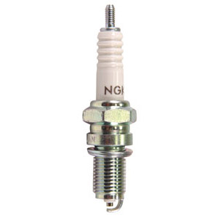
Using the models to the left, order them so that they sequentially show the strokes in order. Make sure that one shows the exhaust stroke just before TDC. Adjust the valves so that they are in their proper position (open or closed)
Intake
Exhaust
Intake
Exhaust
Intake
Exhaust
The 4-cycles
NOTE: the valves, crank, piston, and piston rod can all be manipulated in these models.
Intake
Exhaust
Intake
Exhaust
Intake
Exhaust
When are both valves open (valve overlap)? Why does this occur?
Attribution 3.0 Unported (CC BY 3.0)

Slide 9
Calculating Engine Volume & Piston Surface Area
 | 1 Unit square | 3 units square (27 ___³)
Centimeters
Inches
Area of circle:
Circle: d × 𝜋
Volume Formulas:
Cubes: s³ (l x w x h)
Cylinders: 𝜋 × r² × h
or 0.7854 × (Bore)² × Stroke
What does the textbook say about finding Top Dead Center and Bottom Dead Center?
Key Terms:
Top Dead Center
Bottom Dead Center
Throw (crank)
Displacement
What is the compression ratio of your engine?
What is the relationship between piston area, cylinder volume and work?
Using your repair manual, IPL, and technical specifications documents, calculate the stroke length of your engine.
Label all dimensions on the diagram of the cylinder & piston.
My Engine:
Piston Surface Area: __________
Bore Diameter: _______________
Bore Radius: _________________
Stroke Length: ________________
Engine Displacement: __________

Slide 10
Visualizing differences in volume
Using blank paper draw out the shape to the left four times. For the 4 shapes, change the side lengths to 1 cm, 6 cm, 1”, and 3”
Photograph the 4 cubes you create side by side. How do they compare?
What mathematical expression could represent the relationships of the volumes?

Slide 11

Assume that each of the engines listed below has an identical stroke of 2.5 inches (height of column). They do not, but for simplification, assume they do.
Graph the surface area vs volume (displacement) for each of the five engine series listed.
Using your graph, estimate the piston bore size for the following theoretical engines:
6 Hp :________
9 Hp: ________
Briggs Horsepower Rating | Piston Bore (diameter in inches) | Total Surface Area (in²) | Total surface area (cm²)
2-3Hp | 2.375
4Hp (3-5) | 2.5625
130G000 | 2.76
8Hp (7-8.5) | 3.010
10Hp (10-18) | 3.4375

Slide 12

Horsepower
Name | Description
Brake Horsepower
Friction Horsepower
Indicated Horsepower
“Although many small engines are rated in horse-power, the actual amount of power and work and engine can produce depends on the amount of torque produced by the engine in relation to the engine’s drive shaft” (Radcliff, 2016, p. 15).

Slide 13
Engine Speed
Using. Your graph to justify your explanation, what effect does the engine going faster have on the amount of fuel-air mixture drawn into the cylinder?
What effect does this change have on power (pressure or torque placed on the piston head)?
Intake
Exhaust
The amount of fuel an engine can bring in through the intake valve is limited by how quickly air can mix with the fuel and move through the carb and into the cylinder. Physical limiting factors maximize the total fuel able to get into the engine.
Assuming that the fastest a cylinder can fill is 1/60 of a second, create a graph which shows the amount of fuel drawn into the engine over a range of speeds from 3,000-4,200 rpm. Use the following chart to help construct your graph.
HINT: a cylinder cannot fill over 100%.
RPM | Sec/revolution | % of Cylinder full
3,000
3,300
3,600 | 1/60 | 100
3,900
4,200

Slide 14
Using words AND pictures, define each of the following terms:
Energy Conversion
Heat
Force
Pressure

Slide 15
Using words AND pictures, define each of the following terms:
Torque
Work
Horsepower
Chemistry

Slide 16
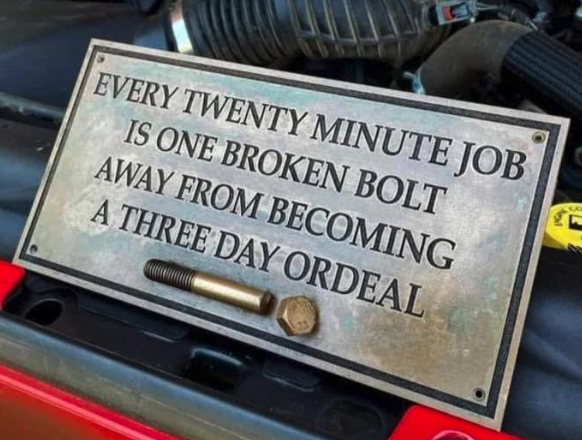
The next several slides have engine parts photos.
As we go through your 2 engines in the class you are required to change the stock photos to photos from your engines if your engine has the part.
On the right side of each page in the notes section you will use the Illustrated Parts List for your engine to provide a line-art image, a part number, and to look-up the prices for the part from two sources. Shipping charges should be listed as well.
Following the parts slides, are blank slides for tools. For each of the engine components, include the tools required to service that part.
The first slide should be used to show all the general tools you need for more than one part (sockets, ratchets, screw drivers, etc.
Major Engine Parts & Pieces

Slide 17
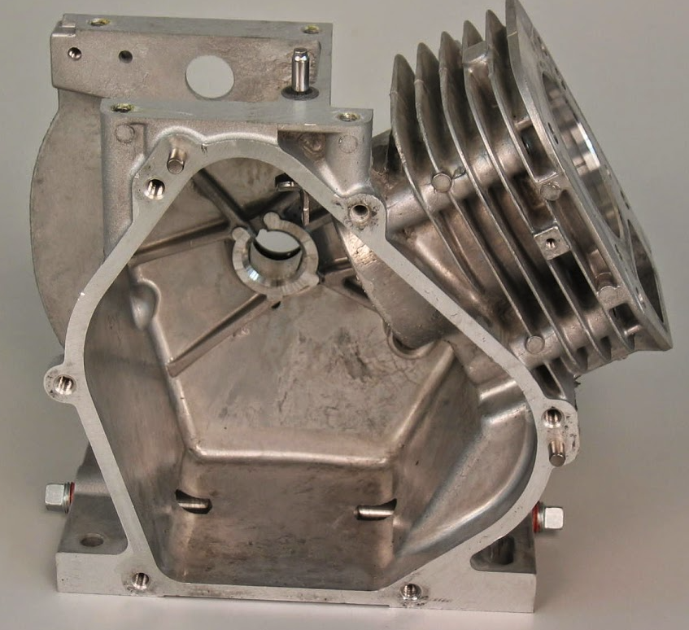
Using the Illustrated Parts List (IPL), Include a part number for each part. If it is an assembly, list both the individual components and the complete assembly as separate parts.
Engine Components
Part Name:
Part Number:
Using the PowerPortal Parts Look-up, what is the current part number for ordering a replacement part:
What is this/these parts role in the function of the engine?

Slide 18
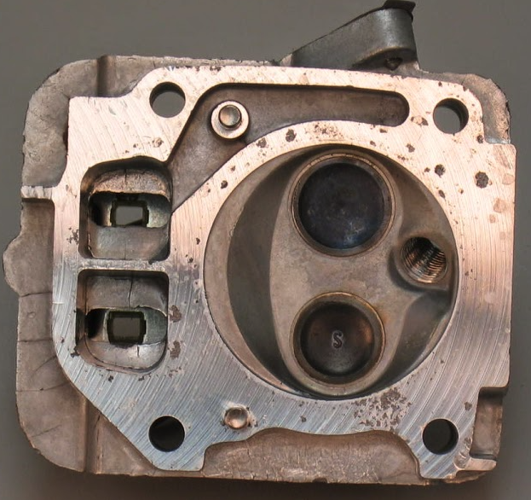
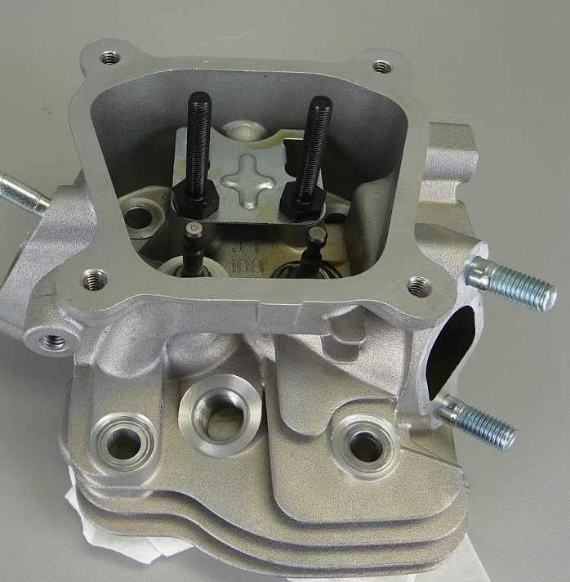
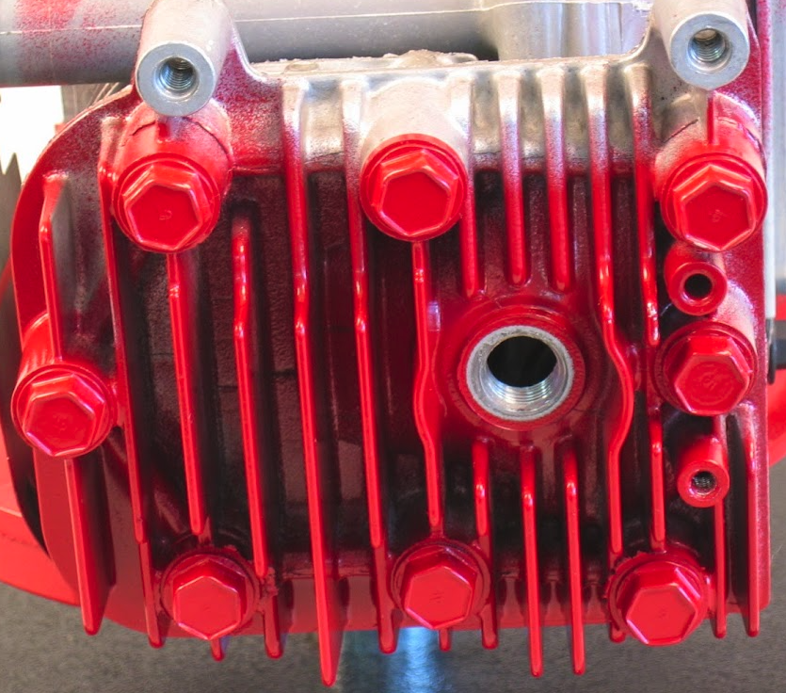
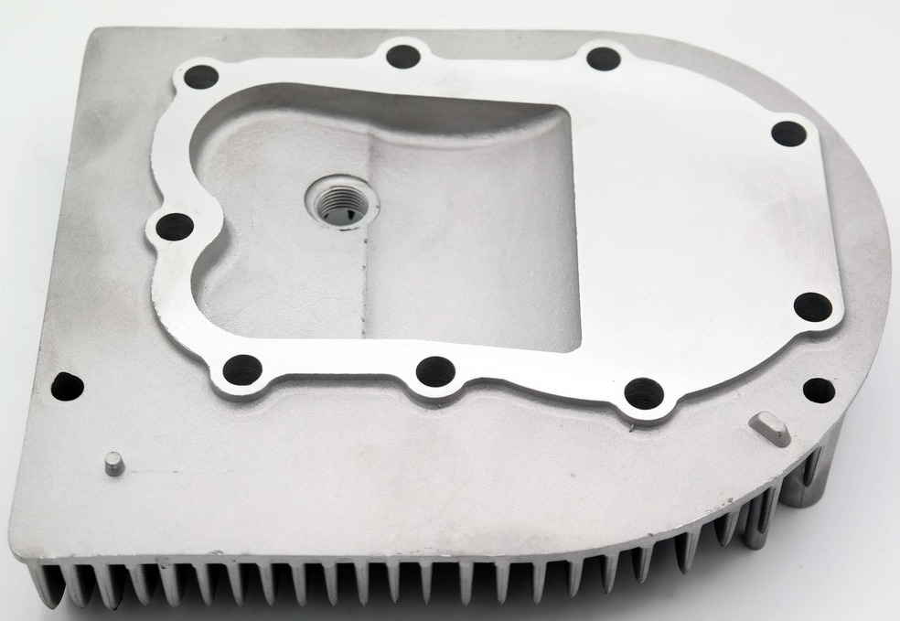
Using the Illustrated Parts List (IPL), Include a part number for each part. If it is an assembly, list both the individual components and the complete assembly as separate parts.
Engine Components
Part Name:
Part Number:
Using the PowerPortal Parts Look-up, what is the current part number for ordering a replacement part:
What is this/these parts role in the function of the engine?
The following parts are considered part of or located inside the head of overhead valve engines.
  Head gasket
  Locating Pin
  Rocker Arm
  Rocker arm stud
  Valve Cover
  Valve cover gasket
  Valve Cap
  Lift/Push Rod

Slide 19
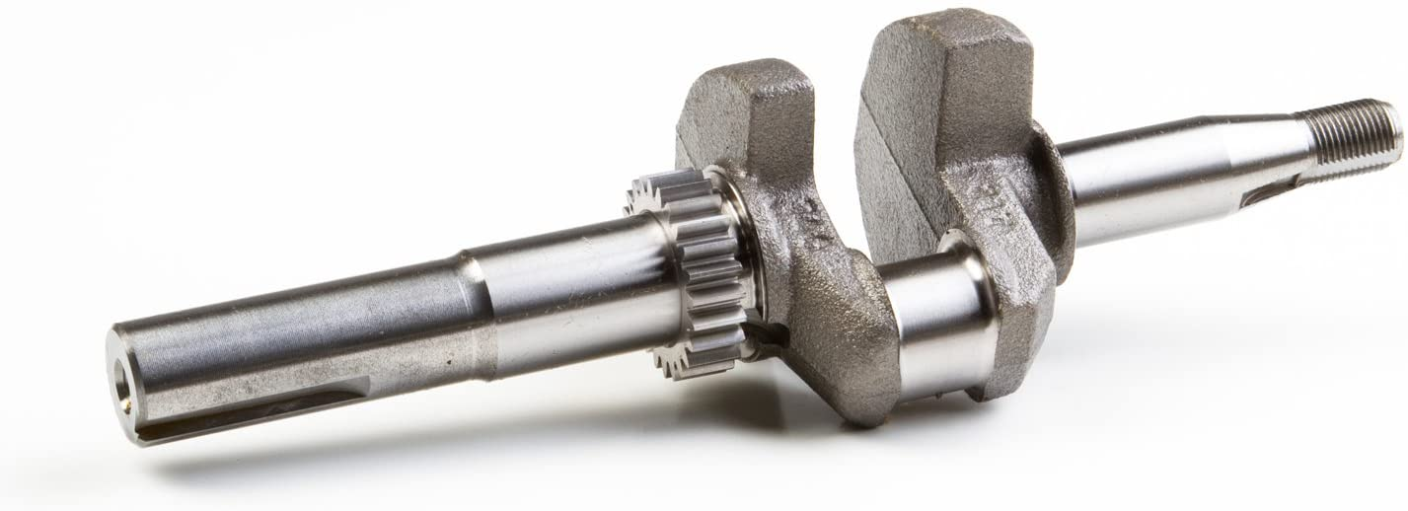
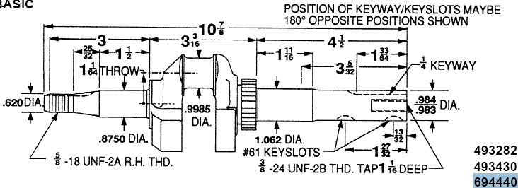
Using the Illustrated Parts List (IPL), Include a part number for each part. If it is an assembly, list both the individual components and the complete assembly as separate parts.
Engine Components
Part Name:
Part Number:
Using the PowerPortal Parts Look-up, what is the current part number for ordering a replacement part:
What is this/these parts role in the function of the engine?

Slide 20
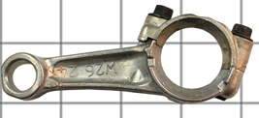
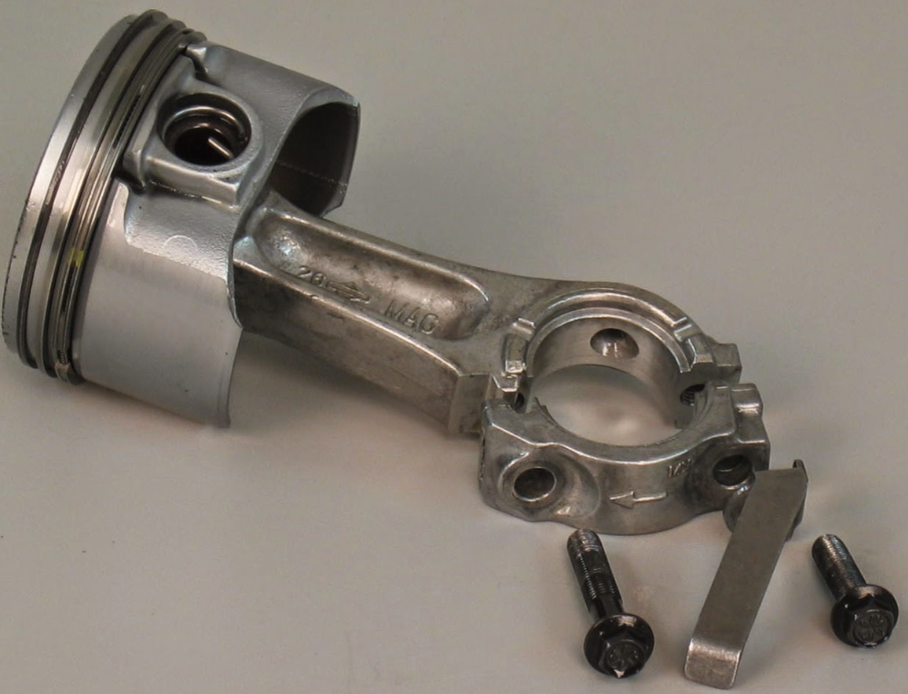
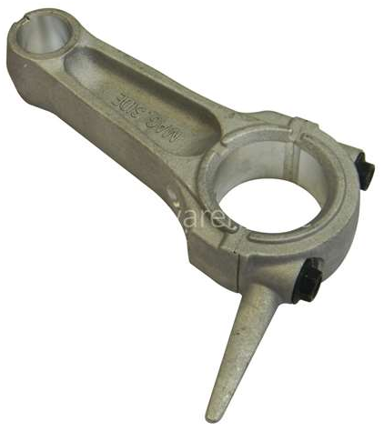
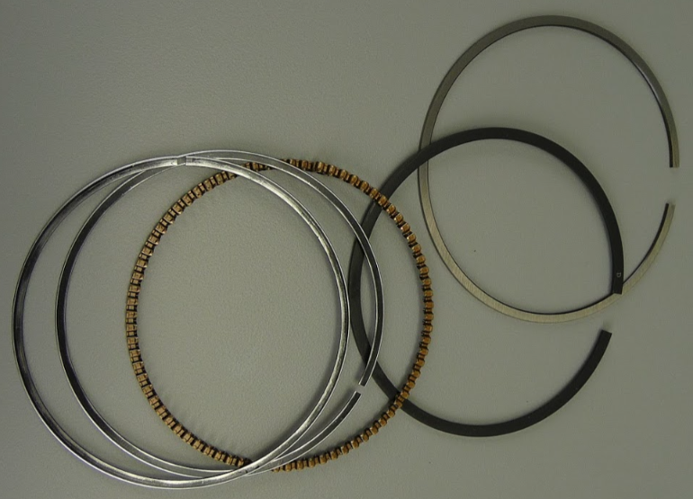
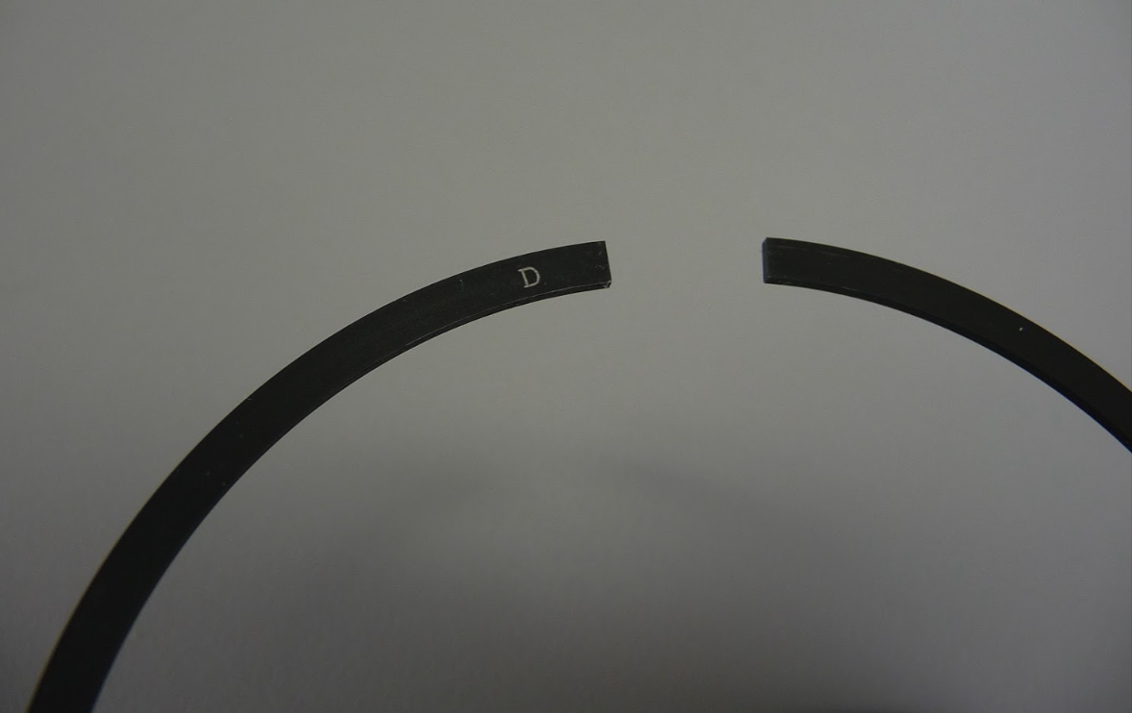
Engine Components
Part Name:
Part Number:
Using the PowerPortal Parts Look-up, what is the current part number for ordering a replacement part:
What is this/these parts role in the function of the engine?
Using the Illustrated Parts List (IPL), Include a part number for each part. If it is an assembly, list both the individual components and the complete assembly as separate parts.

Slide 21
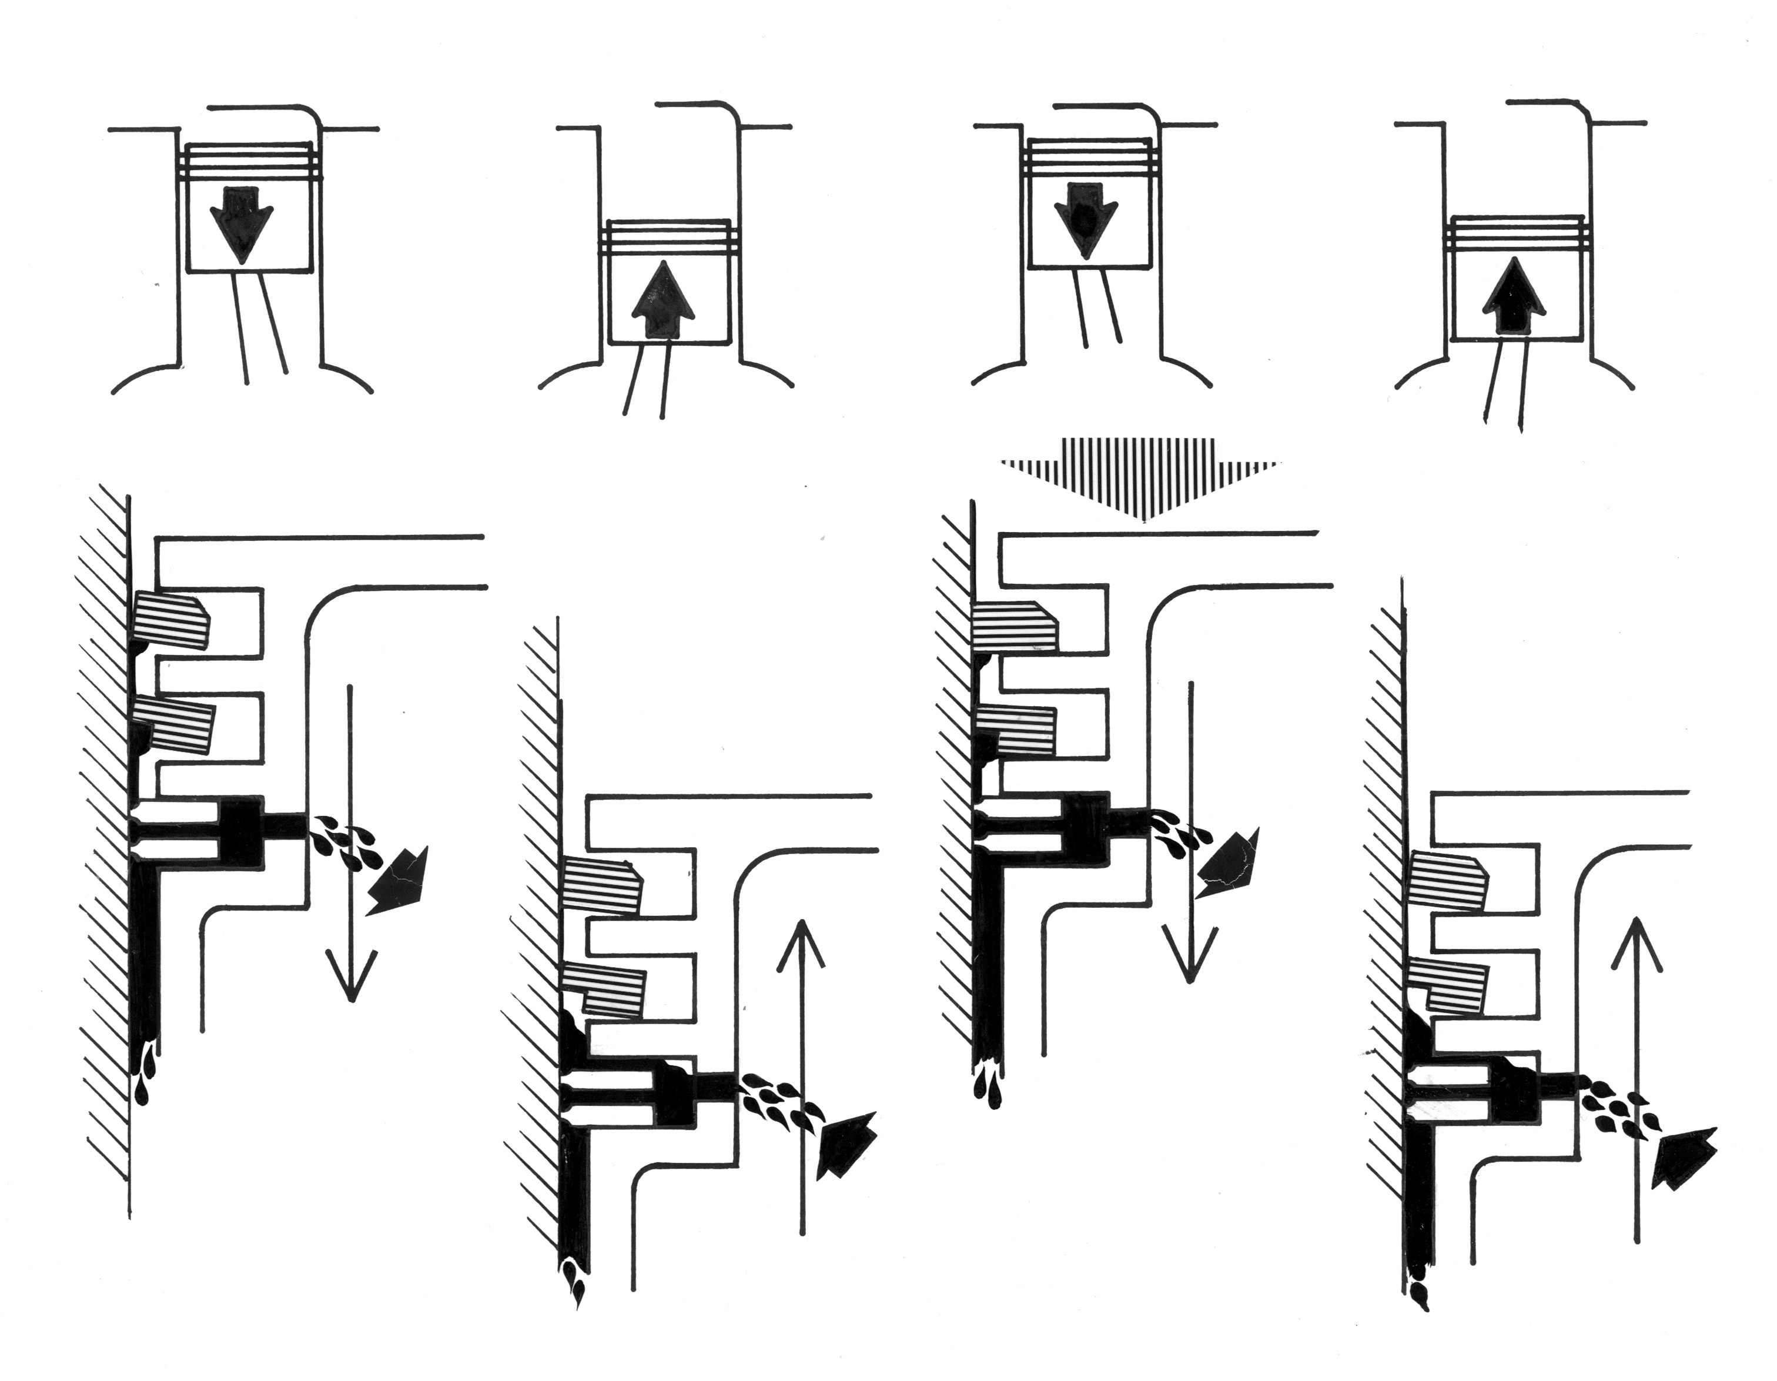
Piston Rings
How rings work:
Using the diagram to the left, explain the roles of the rings in each of the strokes. Identify the stroke, air pressures (relative), and what each ring is doing.

Slide 22
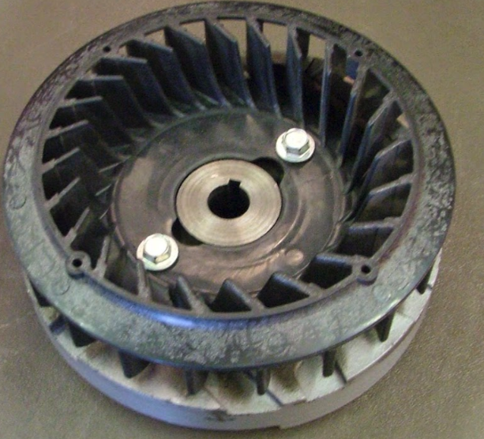
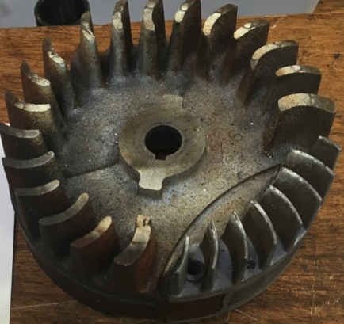
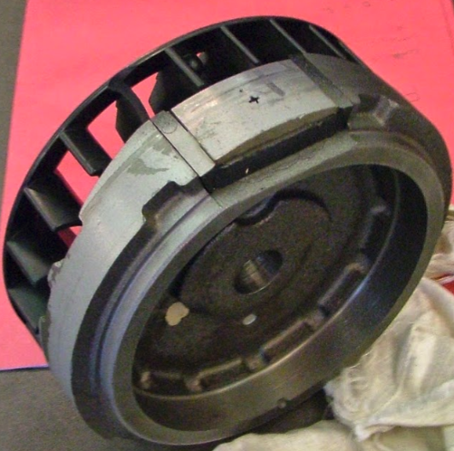
Using the Illustrated Parts List (IPL), Include a part number for each part. If it is an assembly, list both the individual components and the complete assembly as separate parts.
Engine Components
Part Name:
Part Number:
Using the PowerPortal Parts Look-up, what is the current part number for ordering a replacement part:
What is this/these parts role in the function of the engine?
What effect does changing (size, shape, thickness, spacing) the fins have on the engine? (Ch 8)
Attribution 3.0 Unported (CC BY 3.0)

Slide 23
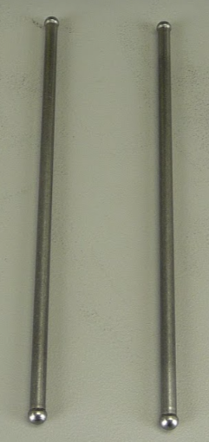
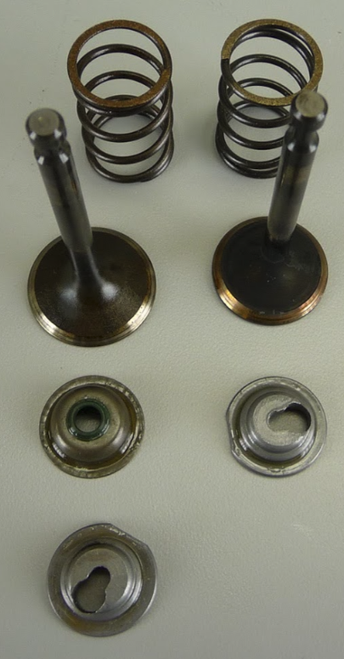
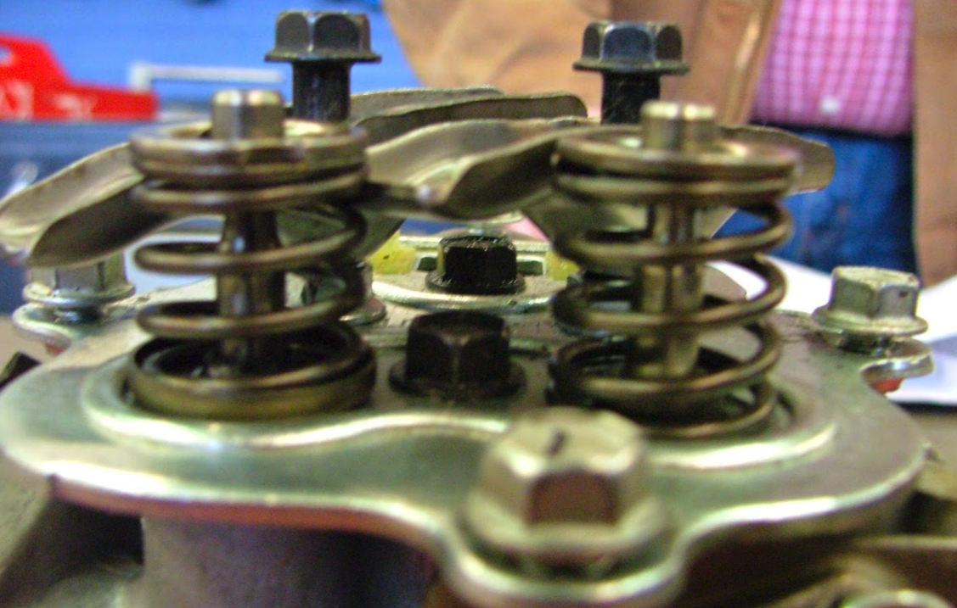
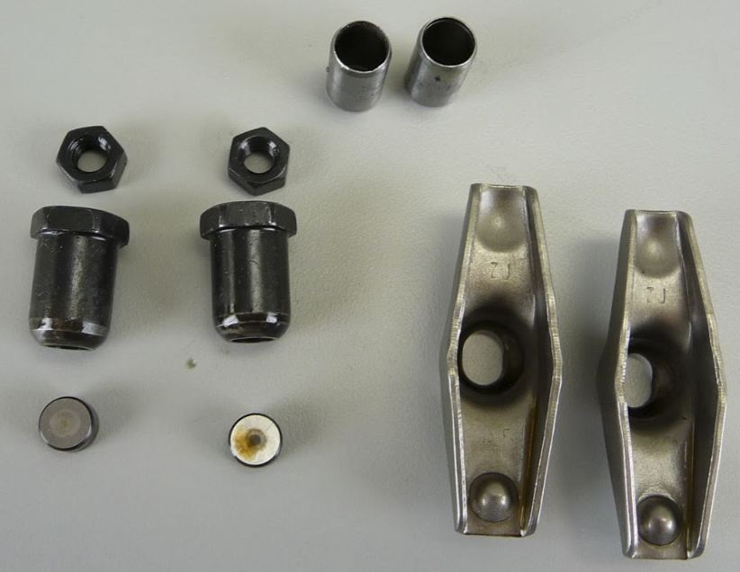
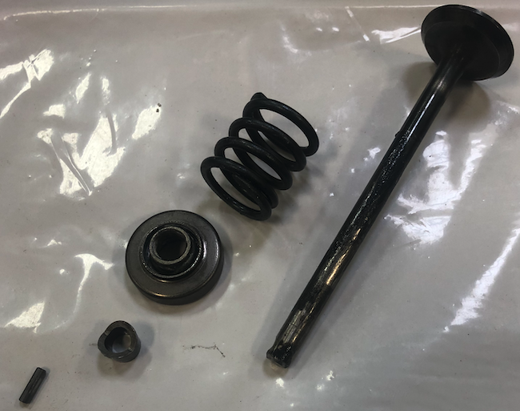
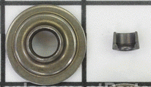
Engine Components
Part Name:
Part Number:
Using the PowerPortal Parts Look-up, what is the current part number for ordering a replacement part:
What is this/these parts role in the function of the engine?
Using the Illustrated Parts List (IPL), Include a part number for each part. If it is an assembly, list both the individual components and the complete assembly as separate parts.
Attribution 3.0 Unported (CC BY 3.0)

Slide 24
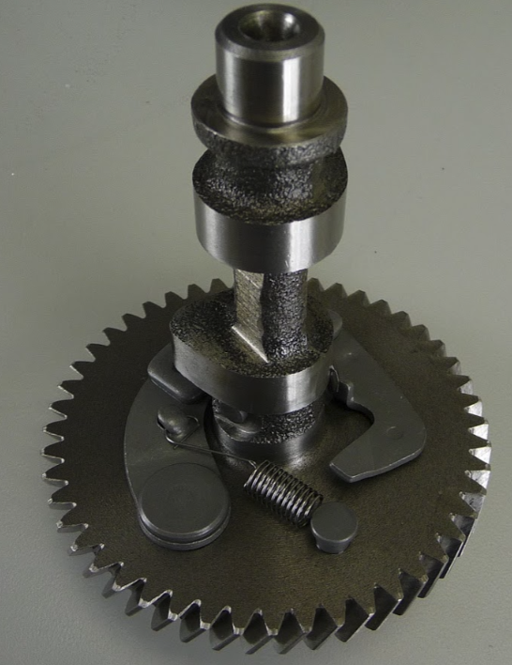
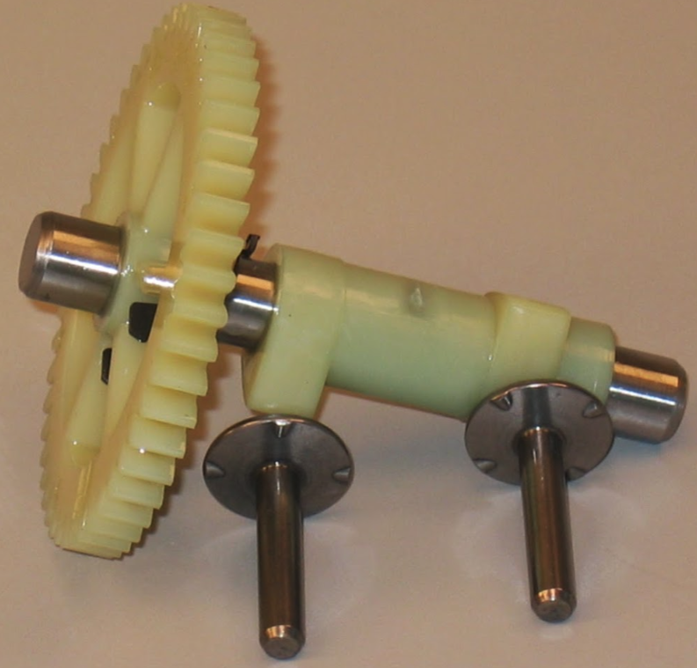
Using the Illustrated Parts List (IPL), Include a part number for each part. If it is an assembly, list both the individual components and the complete assembly as separate parts.
Engine Components
Part Name:
Part Number:
Using the PowerPortal Parts Look-up, what is the current part number for ordering a replacement part:
What is this/these parts role in the function of the engine?
Attribution 3.0 Unported (CC BY 3.0)

Slide 25
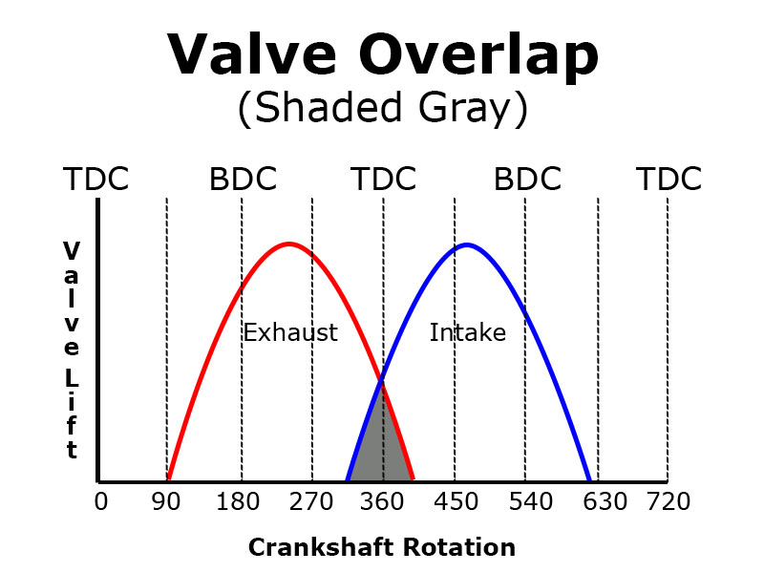
Valve Overlap
Valve overlap occurs between which 2 strokes?
What is the role of valve overlap in engine function?
Take a photograph of your engines Cam Gear. Photograph down the length of the main shaft with the lobes in clear view and the gear at the back of the photo.
Using the insert drawing shapes function, add lines to show where on the cam lobes the overlap occurs.
Insert CAM Gear photo here as Shape Fill
SAMPLE LINES & ARROWS
Hint: these lines are NOT in the correct location
Notes:
Valve Overlap Chart from: https://help.summitracing.com/app/answers/detail/a_id/4703/~/what-is-valve-overlap%3F

Slide 26
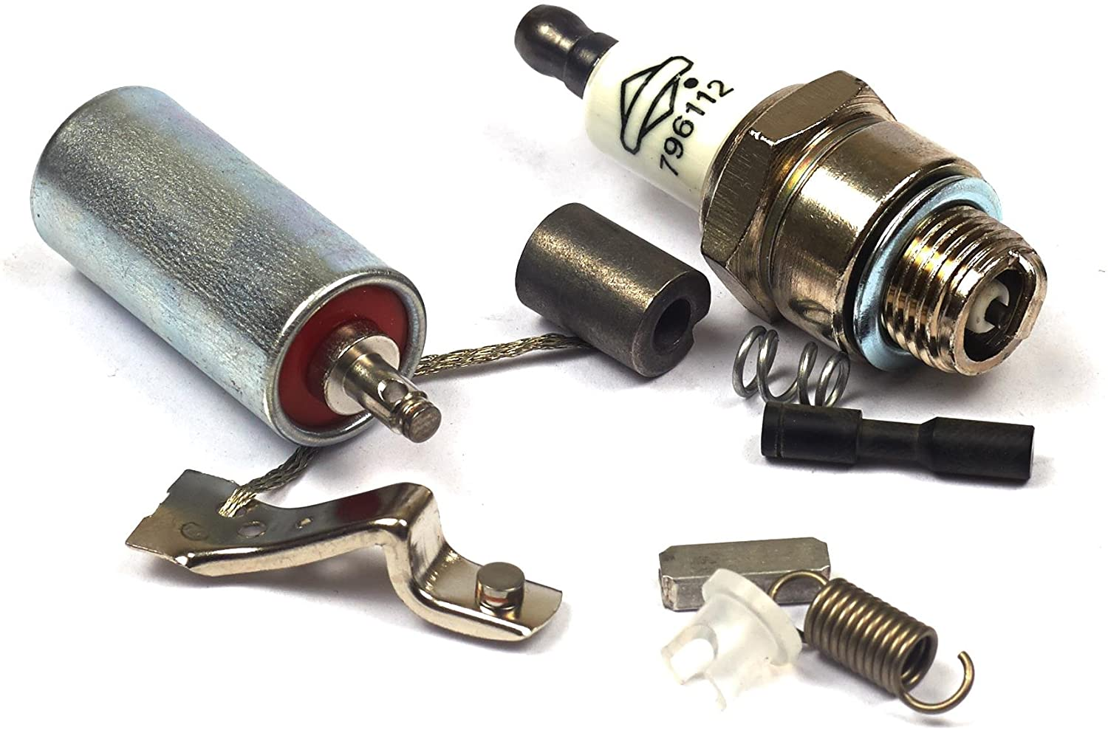
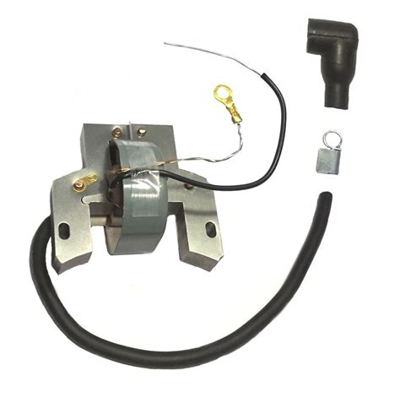
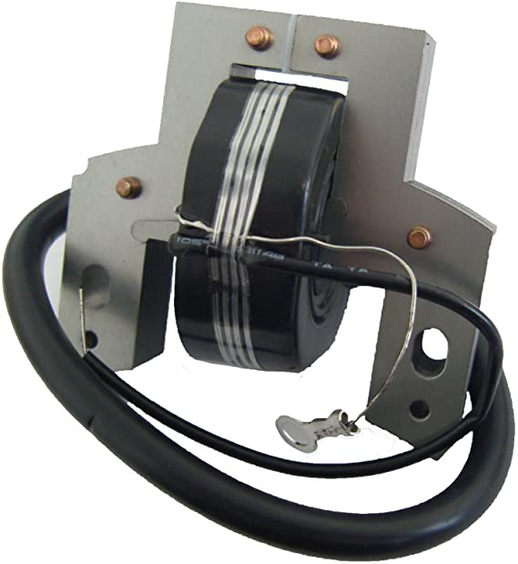
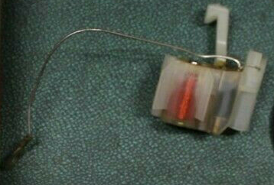
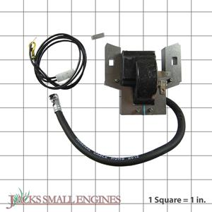
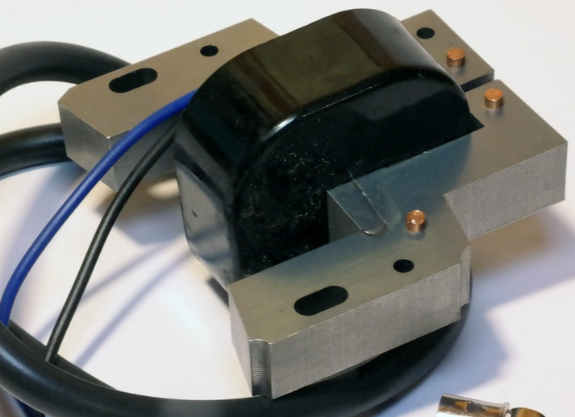
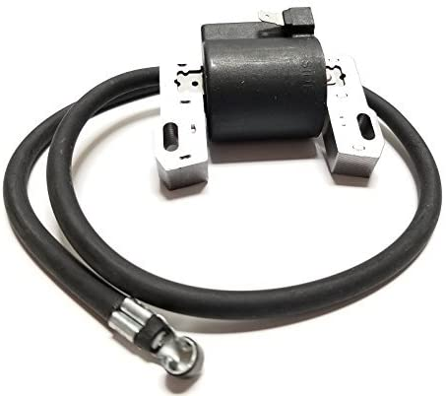
Require 350 rpms
Standard and Advancing Ignition modules. Care must be taken to replace armatures designed for the engine. Flywheels are paired with armatures and the key is located differently for advancing armatures. 250 RPM
Modern Armature
Spark/Ignition
Part Name:
Part Number:
Using the PowerPortal Parts Look-up, what is the current part number for ordering a replacement part:
What is this/these parts role in the function of the engine?
Using the Illustrated Parts List (IPL), Include a part number for each part. If it is an assembly, list both the individual components and the complete assembly as separate parts.
https://www.briggsandstratton.com/eu/en_gb/support/faqs/browse/ignition-system-theory-and-testing.html
https://www.briggsandstratton.com/na/en_us/support/faqs/browse/ignition-system-theory-and-testing.html
Attribution 3.0 Unported (CC BY 3.0)

Slide 27
Armature Components & their Function
Label the parts of the Armature. Include the function of each of these armature components:
  Frame
  Coil
  Electronic ignition module
  Primary wire
  Secondary wire

Slide 28
Combined Tool Requirements For All Labs
10mm Wrench
12mm Wrench
13mm Wrench
14mm Wrench
Two “C” Clamps
Safety Glasses
Funnel
8 mm Socket, 3/8 in. Drive
10 mm Socket, 3/8 in. Drive
16mm Socket 3/8 in. Drive Spark Plug
Extension, 3/8 in. Drive
Ratchet, 3/8 in. Drive
Inch Pound Torque Wrench
Standard Screwdriver
Needle Nose Pliers
Pliers
Flat Feeler Gauge Set
Breaker Bar, ½ in. Drive
21mm Socket ½ in. Drive
Strap Wrench
Foot Pound Torque Wrench
CE5121 B&S Air Gap Gauge
19368 B&S Spark Tester
Small Engines Ring Compressor
Ring Expander
Ring Land Cleaner
2 Jaw Gear Puller
Inside Micrometer
Outside Micrometer
Dial Indicator gauge
Small Hole Gauge
Telescoping Gauge
Each of these tools should be accounted for in the following pages. If additional tools are used, please include them as well.
Attribution 3.0 Unported (CC BY 3.0)

Slide 29
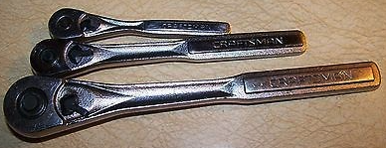
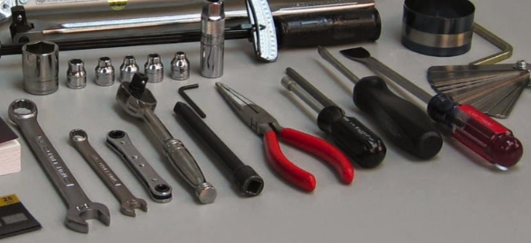
Tools of the Trade
Place only one tool in each cell of the table. Type the name of the tool in each cell, then add the photograph. These should be of the actual tools used in class, not ones from the internet.
The first 9 tools are listed to help you get started. When you are completed, every tool from the ID list (below in notes) should be pictured. Copy and paste additional slides as needed.
Ratchet (1/4”, 3/8”, & ½” drive) Note: your toolbox may not have all 3 | Sockets (list sizes) | Needle Nose Pilers
Extension | Combination End Wrench | Slip Joint Pilers
Phillips Screwdriver | Regular (flat) screwdriver | Feeler Gages
Attribution 3.0 Unported (CC BY 3.0)
Notes:
Tools
Combination End Wrench
Compression tester
Cylinder Leakdown Tester
Dial caliper
Feeler gauge
Flywheel holder
Flywheel puller
Gear puller
Hammer
Ball Peen
Dead Blow
Rubber Mallet
Hex Wrench (Allen)
Micrometer, inside
Micrometer, outside
Pliers
Locking
Needle Nose
Slip-Joint
Tongue & Groove
Punch
Center
Drive Pin
Ratchet
¼” drive
⅜” drive
½” drive
Ring expander
Ring Compressor
Rolling head pry bar
Screw Driver/Bit
Carburetor
Phillips
Standard
Torx
Small-hole gauge
Socket
¼” drive
⅜” drive
½” drive
Spark tester
Standards for micrometers
Starter clutch socket
Strap Wrench
Telescoping gauge
Tachometer
Torque wrench
Valve Spring Compressor

Slide 30
Tools of the Trade
Note: For specialty tools, list both the tool name and the specific parts it’s used on.
Attribution 3.0 Unported (CC BY 3.0)

Slide 31
Tools of the Trade
Note: For specialty tools, list both the tool name and the specific parts it’s used on.
Attribution 3.0 Unported (CC BY 3.0)

Slide 32
Tools of the Trade
Note: For specialty tools, list both the tool name and the specific parts it’s used on.
Attribution 3.0 Unported (CC BY 3.0)

Slide 33
Tools of the Trade
Note: For specialty tools, list both the tool name and the specific parts it’s used on.
Attribution 3.0 Unported (CC BY 3.0)

Slide 34
Tools of the Trade
Note: For specialty tools, list both the tool name and the specific parts it’s used on.
Attribution 3.0 Unported (CC BY 3.0)

Slide 35
Tools of the Trade
Note: For specialty tools, list both the tool name and the specific parts it’s used on.
Attribution 3.0 Unported (CC BY 3.0)

Slide 36
Tools of the Trade
Note: For specialty tools, list both the tool name and the specific parts it’s used on.
Attribution 3.0 Unported (CC BY 3.0)

Slide 37
Tools of the Trade
Note: For specialty tools, list both the tool name and the specific parts it’s used on.
Attribution 3.0 Unported (CC BY 3.0)

Slide 38
Be able to name and tell the function of these additional engine parts and tools:
ENGINE PARTS
Air cleaner
  Oil bath type
  Foam type
  Paper Element type
Armature
Blade brake
Blower housing
Breather
  Breather tube
  Breather grommet
Bushing, magneto end
Bushing, drive end
Cam
  Cam gear
  Cam lobes
  Cam journals
  Timing mark
  Compression release
Connecting rod
  Cap
  Cap bolts
  Cap bolt lock
Control Bracket
Crankshaft
  Drive end journal
  Magneto end journal
  Rod journal
  Timing mark
  Timing Gear
Cylinder
Cylinder head bolts
Cylinder shield
Flywheel
Flywheel key
Governors
  Air vane type (pneumatic)
  Mechanical type
  Governor spring
  Governor link
  Governor link spring
Head
  Cylinder head plate
  Head gasket
  Locating Pin
  Rocker Arm
  Rocker arm stud
  Valve Cover
  Valve cover gasket
  Valve Cap
  Lift/Push Rod
Intake tube
Kill switch
Muffler
Oil dipper
Oil slinger
Oil seals
Piston
  Piston pin
  Piston pin lock
  Compression ring
  Oil ring
  Scraper ring
  Ring lands
  Ring grooves
  Ring land clearance
  Ring end gap
Starter ratchet or clutch
Sump or engine base
Tappets
Valves
  Exhaust valve
  Exhaust valve spring
  Intake valve
  Intake valve spring
  Valve spring retainer
  Valve guides
  Valve seat
  Tappet clearance
Carburetors
Flo-jet Carburetor (Bowl type)
  Float
  Float needle
  Needle Seat
  Choke butterfly
  Main jet
  High-speed mix. screw
  Idle mix. adj. screw
  Idle speed screw
  Throttle butterfly
  Throttle shaft bushings
  Venturi
Pulsa-jet Carburetor
  Diaphragm
  Fuel pipe
  High-speed mixture screw
  Idle speed screw
  Throttle shaft
  Needle seat
Tools
Combination End Wrench
Compression tester
Cylinder Leakdown Tester
Dial caliper
Feeler gauge
Flywheel holder
Flywheel puller
Gear puller
Hammer
  Ball Peen
  Dead Blow
  Rubber Mallet
Hex Wrench (Allen)
Micrometer, inside
Micrometer, outside
Pliers
  Locking
  Needle Nose
  Slip-Joint
  Tongue & Groove
Punch
  Center
  Drive Pin
Ratchet
  ¼” drive
  ⅜” drive
  ½” drive
Ring expander
Ring Compressor
Rolling head pry bar
Screw Driver/Bit
  Carburetor
  Phillips
  Standard
  Torx
Small-hole gauge
Socket
  ¼” drive
  ⅜” drive
  ½” drive
Spark tester
Standards for micrometers
Starter clutch socket
Strap Wrench
Telescoping gauge
Tachometer
Torque wrench
Valve Spring Compressor
Attribution 3.0 Unported (CC BY 3.0)

Slide 39
MST EXAM 2:
Carbs and EFI

Slide 40
Vaccu-jet Carburetor
Carbs. Upload and label your engines carb completely disassembled.
Each part should include a clear photograph and be correctly labeled. More than one part per photo is allowed so long as they are all clear.
Note: You may not have resources for all three types of carburetors. Please delete the pages for which you do not have the resources available for students to use.
Attribution 3.0 Unported (CC BY 3.0)

Slide 41
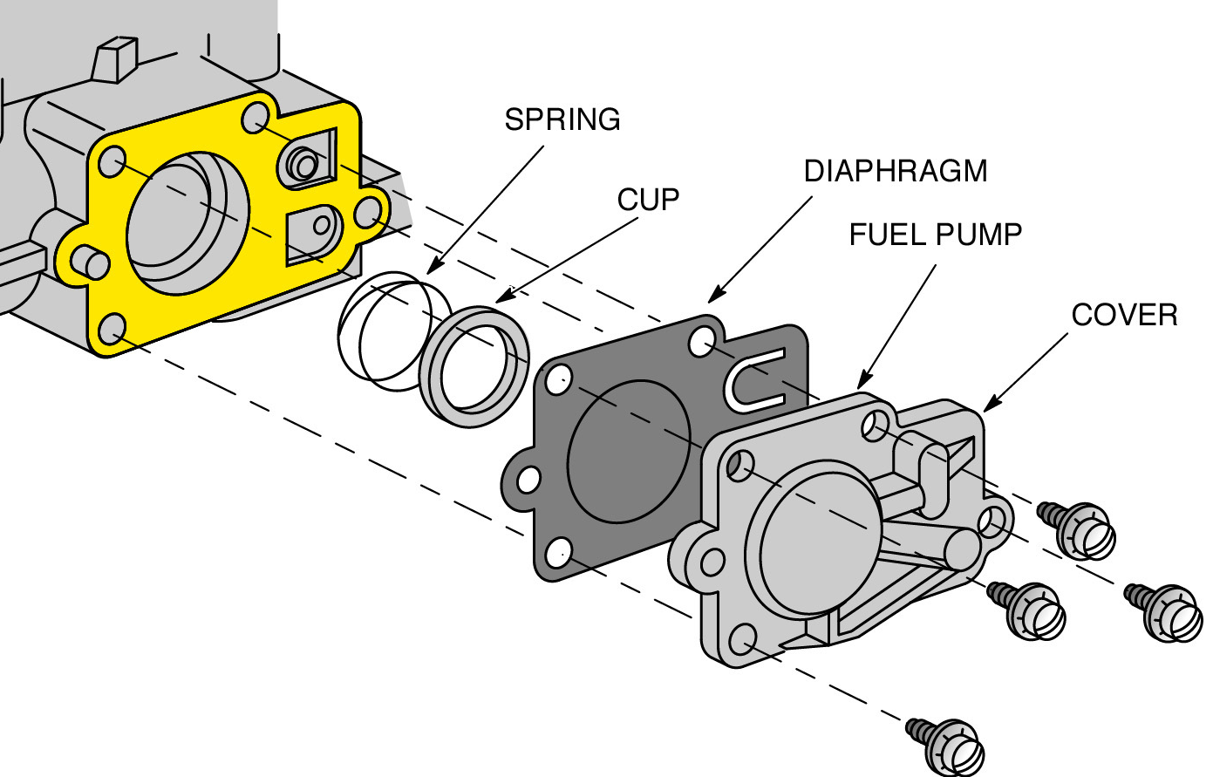
Pulsa-jet Carburetor
Carbs. Upload and label your carb disassembly. Each part should include a clear photograph and be correctly labeled.
Attribution 3.0 Unported (CC BY 3.0)

Slide 42
Flo-jet Carburetor
Carbs. Upload and label your carb disassembly. Each part should include a clear photograph and be correctly labeled.
Attribution 3.0 Unported (CC BY 3.0)

Slide 43
Define and ILLUSTRATE the following
Terms of importance:
Venturi:
Diaphragm (on Vaccu or Pulsa-Jet cabs only):
Up-draft
Down-draft
Side-draft
Emulsion Tube
Jet:
Use this space to insert photos to help in your defining of the terms to the right.
Attribution 3.0 Unported (CC BY 3.0)

Slide 44
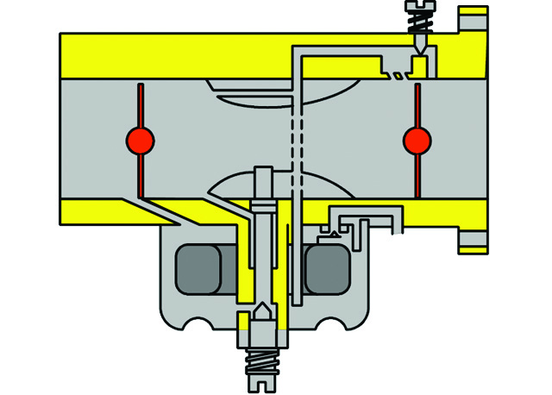
Venturi
Air Flow IN
Increased air speed
reduces air pressure
Air Flow OUT
Atmospheric Pressure in bowl is now HIGHER than air pressure in Venturi causing fuel to rise through emulsion tube

Slide 45
How does a choke work?
The choke plate and throttle plates in this illustration can be rotated by selecting the center shaft and using the rotation arrow.
Using the diagram to the left and after watching the carburation video on the Briggs & Stratton Power Portal, illustrate how a choke plate and bleed circuits work.
Air Flow IN
Air Flow OUT

Slide 46
How does the idle circuit work?
Using the diagram to the left and after watching the carburation video on the Briggs & Stratton Power Portal, illustrate how the idle circuit works. Remember the throttle plate never fully closes!
The choke plate and throttle plates in this illustration can be rotated by selecting the center shaft and using the rotation arrow.
Air Flow IN
Air Flow OUT

Slide 47
Use this space and the diagrams to the left to describe the idle circuit.
Attribution 3.0 Unported (CC BY 3.0)

Slide 48
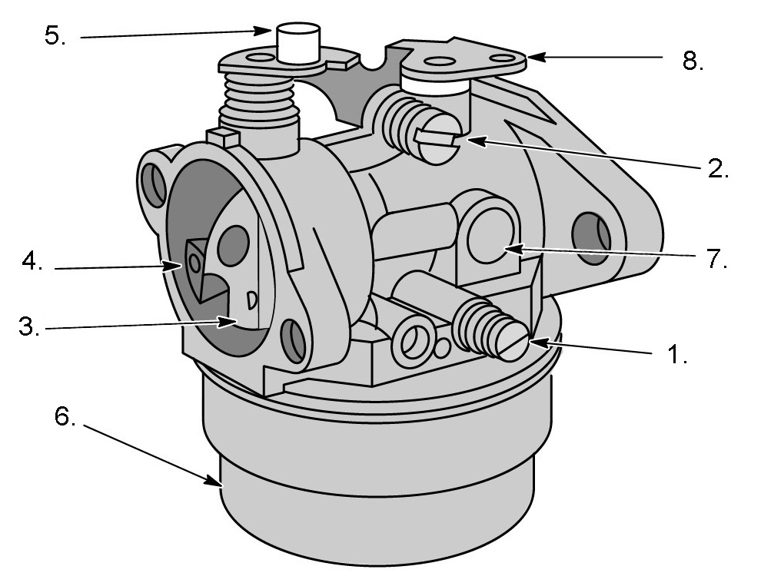
Parts of the Flo-jet Carb:
1.
2.
3.
4.
5.
6.
7.
8.
Attribution 3.0 Unported (CC BY 3.0)

Slide 49
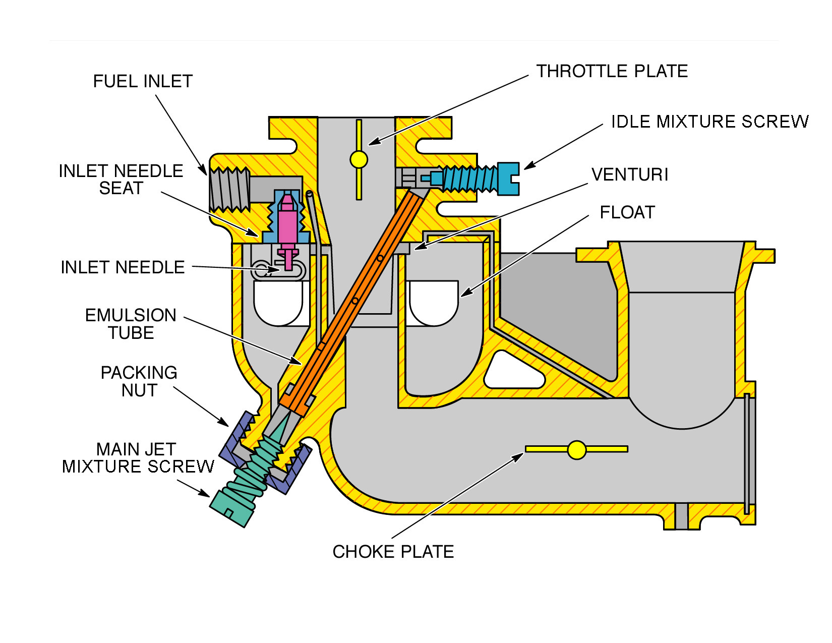
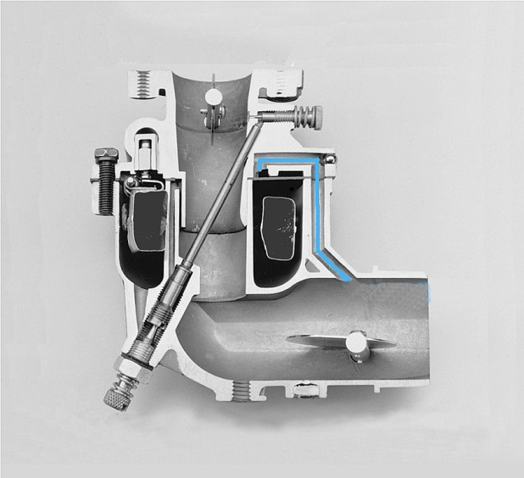
The blue line in the bottom photo is in what part of the carb?
What function does this serve?
What happens if it gets plugged?
What are the advantages/disadvantages of venting it internally vs externally?
Attribution 3.0 Unported (CC BY 3.0)

Slide 50
Carb Disassembly, Inspection & Reassembly
https://www.briggsandstratton.com/eu/en_gb/support/faqs/browse/carburetor-rebuild.html#Step1
Using the Briggs How-to guide as your instruction, disassemble and reassemble your carb. Take photos as you go and create your own how to guide.
Step 1: | Step 2: | Step 3:
Step 4: | Step 5: | Step 6:
Step 7 | Step 8 | Step 9:
Attribution 3.0 Unported (CC BY 3.0)

Slide 51
Attribution 3.0 Unported (CC BY 3.0)

Slide 52
Attribution 3.0 Unported (CC BY 3.0)

